Slide 1
Netflix Movie Recommender System
Using Natural Language Processing and Cosine Similarity
Name: Gaurav Kumar
Student Id: INTERNSHIP_171273103266163398a8c87
Group no.: B1 G4 edunet Mail: gauravk8271@edunetmail.com
personal mail : gauravk8271@gmail.com
Institute name: IIT kharagpur
phone: 6204780646

Slide 2
OUTLINE
Introduction
Dataset Overview
Data Preprocessing
Feature Extraction
Model Training
Recommendations
Conclusion
Future Scope
References

Slide 3
PROBLEM STATEMENT
Objective: Develop a movie recommender system to suggest movies based on user preferences.
Importance: Enhances user experience by providing personalized movie recommendations.
Applications: Used by streaming services like Netflix, Amazon Prime, and Hulu to improve user engagement and satisfaction.

Slide 4
PROPOSED SOLUTION
Develop a content-based movie recommender system using natural language processing (NLP) and cosine similarity to suggest movies based on descriptions and genres.
Key Steps:
Data Collection:
Use a dataset with id, title, overview, and genre.
Data Preprocessing:
Handle missing values and ensure consistency.
Create tags by combining overview and genre.
Feature Extraction:
Convert tags into numerical vectors using CountVectorizer.
Model Training:
Compute cosine similarity between movie vectors.
Recommendation System:
Implement a function to recommend movies based on similarity scores.
Evaluation and Improvement:
Assess recommendation accuracy.
Explore enhancements like additional features and advanced NLP techniques.
Deployment:
Save the model and similarity matrix using pickle.
Develop a user interface for real-time recommendations.
Benefits:
Personalized movie recommendations.
Enhanced user experience.
Scalable for large datasets and real-time use.

Slide 5
Dataset overview
Source: Movie metadata dataset containing information about various movies.
Key Columns: id, title, overview, genre.
Initial Exploration:
Displayed the first 10 records to understand the structure of the data.
Descriptive statistics to get an overview of the dataset.
Checked for missing values and data types to ensure data quality.

Slide 6
Data Processing
Column Selection: Focused on id, title, overview, and genre.
Feature Engineering:
Created a new feature tags by combining overview and genre.
This new feature helps in capturing the essence of the movie plot and genre.
Column Dropping: Removed the original overview and genre columns to simplify the dataset.

Slide 7
Feature Extraction
Vectorization Technique: Used CountVectorizer to convert text data into numerical vectors.
Parameters: max_features=10000 (limits the number of features to 10,000 most frequent words), stop_words='english' (removes common English stop words).
Transformation: Converted the tags feature into vectors.
Result: Obtained a high-dimensional sparse matrix representing the textual data.

Slide 8
Model Training
Similarity Measure: Used cosine similarity to measure the similarity between movies.
Cosine Similarity: Measures the cosine of the angle between two vectors, capturing the similarity in their direction.
Implementation: Calculated the cosine similarity between all movie vectors to find similar movies.

Slide 9
Recommendations
Example Process:
Identified the index for a specific movie (e.g., "The Godfather").
Sorted movies based on similarity scores to find the most similar movies.
Function Implementation:
Developed a recommand function to recommend movies based on a given title.
Example Output: Provided recommendations for "Iron Man".
Demonstration: Displayed the top 5 similar movies for the given example

Slide 10
RESULT
Key Results:
Data Preprocessing: Combined overview and genre into tags.
Feature Extraction: Converted tags to vectors using CountVectorizer.
Model Training: Calculated cosine similarity between movie vectors.
Recommendation System: Recommended movies based on similarity scores.
Example: For "Iron Man," recommendations included "Iron Man 2," "The Avengers," and "Iron Man 3."
Conclusion:
Efficiently provided personalized movie recommendations.
Future Enhancements:
Add features like cast and ratings.
Use advanced NLP techniques.
Scale for real-time recommendations.

Slide 11
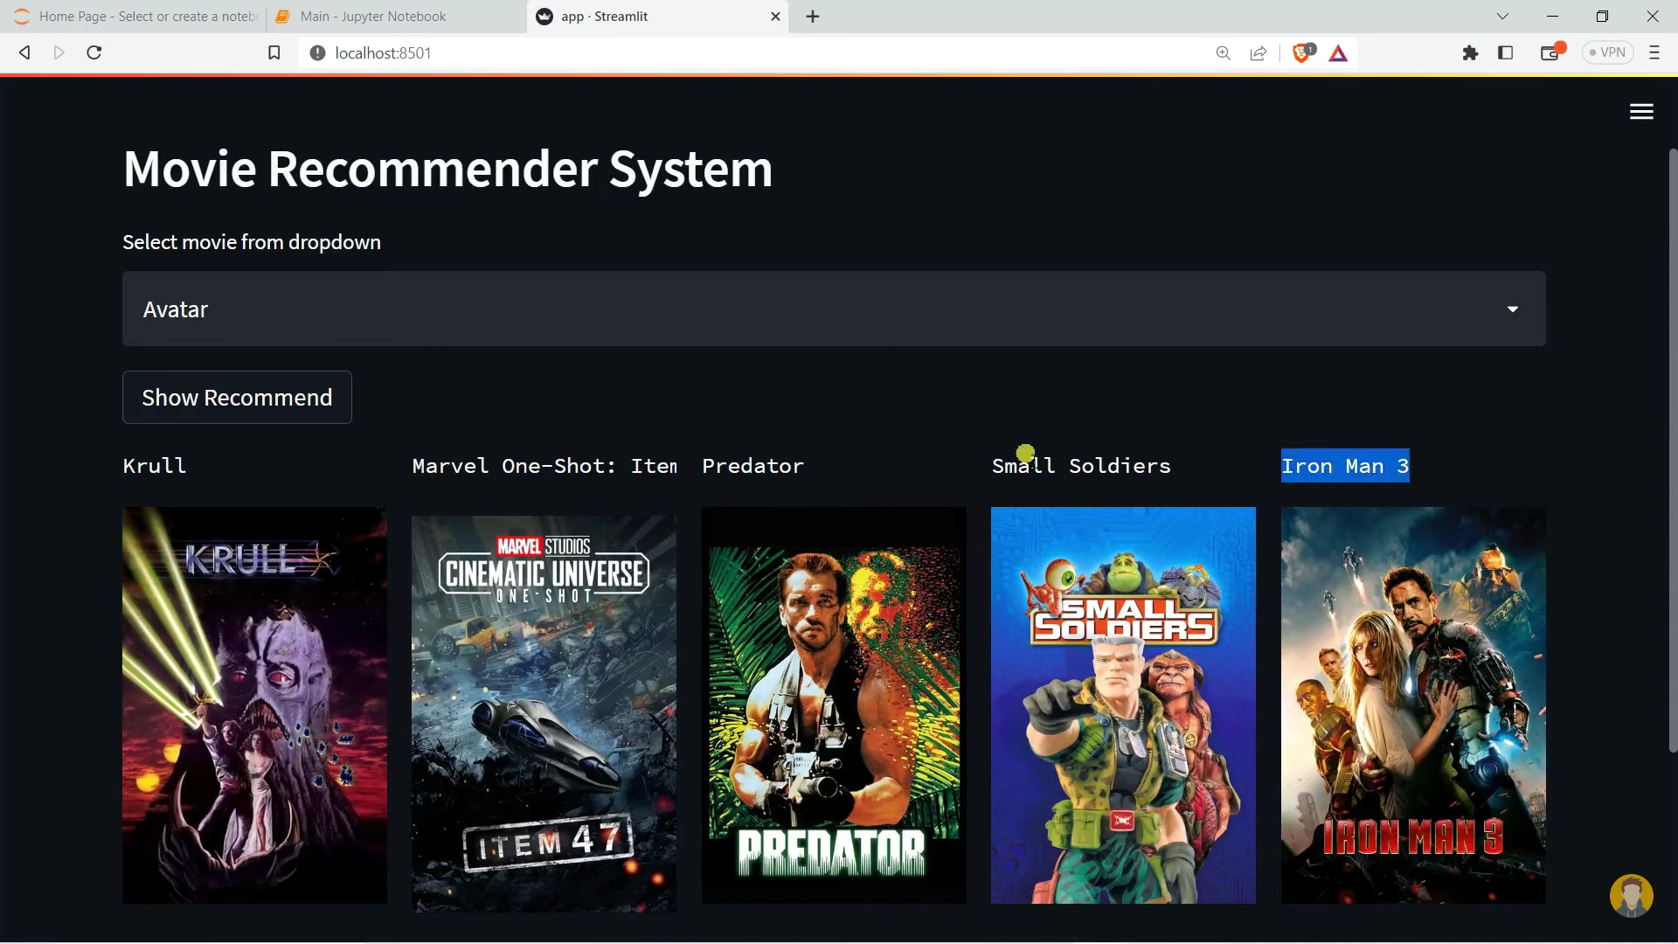
RESULT

Slide 12
PROJECT LINK(GITHUB, GOOGLE DRIVE LINK)
Github : https://github.com/gamerGK/Netflix-movie-recommender-system

Slide 13
CONCLUSION
Summary: Developed a functional movie recommender system using NLP and cosine similarity.
Effectiveness: The system effectively recommends movies based on the content and genre.
Key Takeaways: Highlighted the importance of feature engineering and similarity measures in building a recommender system.

Slide 14
FUTURE SCOPE
Enhanced Features: Incorporate additional features like cast, crew, and keywords to improve recommendations.
Advanced NLP Techniques: Utilize techniques like TF-IDF, Word2Vec, or BERT for better text understanding.
Real-time Recommendations: Develop a scalable solution to provide real-time recommendations.
User Interaction: Incorporate user feedback to continuously improve the recommendation system.

Slide 15
REFERENCES
Resources Used:
Pandas: For data manipulation and analysis.
Scikit-learn: For vectorization and similarity calculations.
Pickle: For saving and loading the trained model and data.
Documentation: Relevant documentation for libraries and tools used.

Slide 16
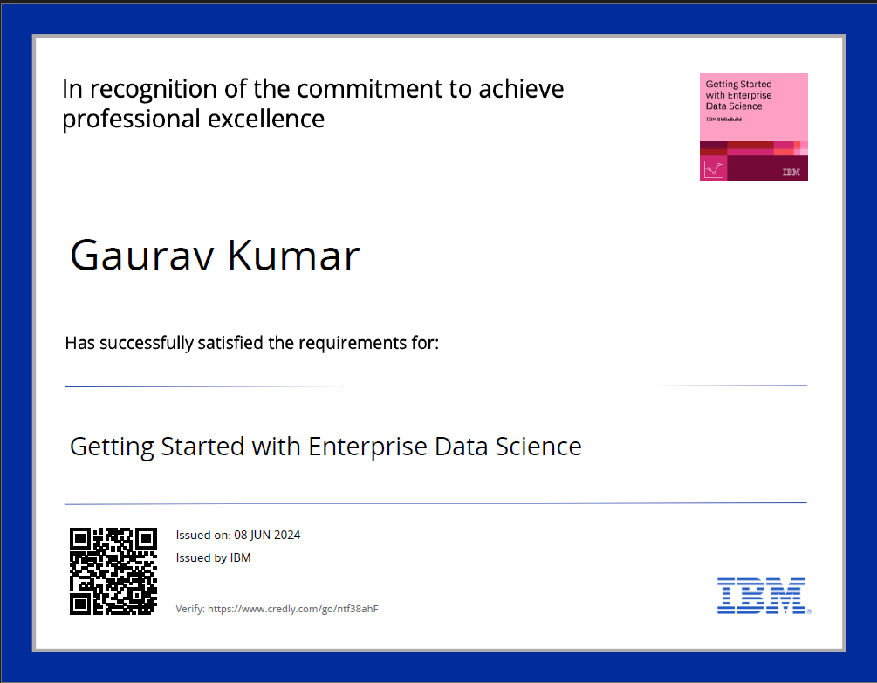
COURSE CERTIFICATE 1
Link: https://www.credly.com/go/ntf38ahF

Slide 17
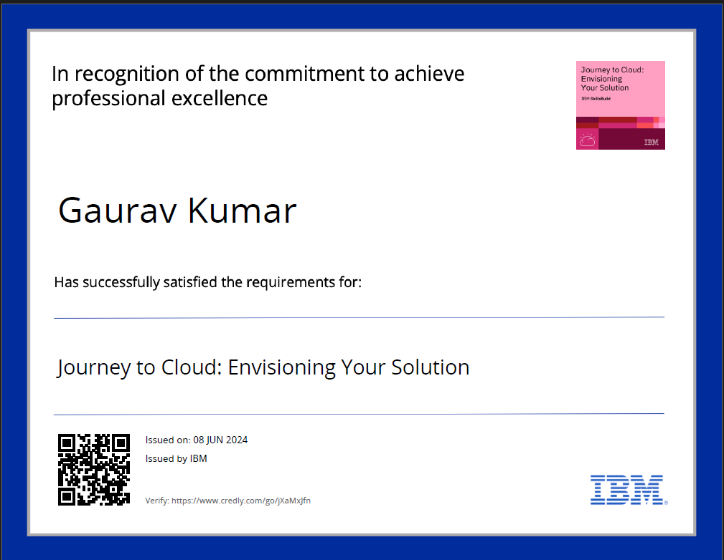
COURSE CERTIFICATE 2
Link: https://www.credly.com/go/jXaMxJfn

Slide 18
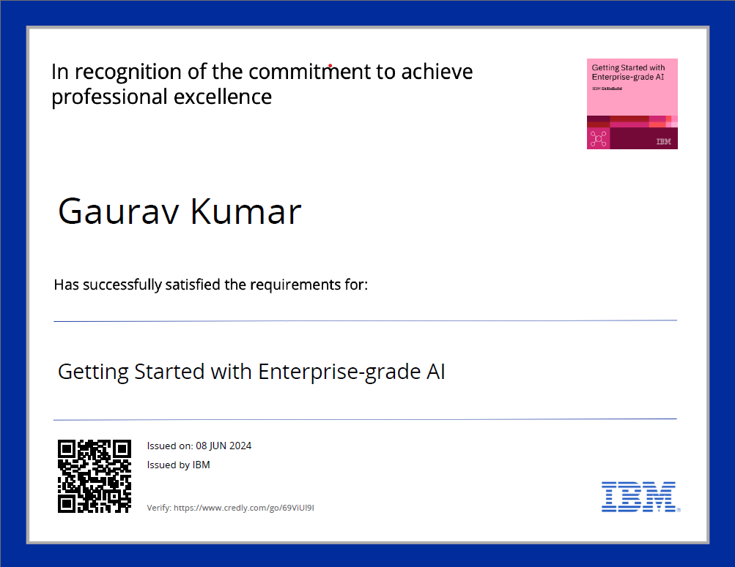
COURSE CERTIFICATE 3
Link: https://www.credly.com/go/69ViUl9I

Slide 19
THANK YOU
Name: Gaurav Kumar
Student Id: INTERNSHIP_171273103266163398a8c87
Group no.: B1 G4 edunet Mail: gauravk8271@edunetmail.com
personal mail : gauravk8271@gmail.com
Institute name: IIT kharagpur
phone: 6204780646

